Slide 1
Countries Clustering Assignment
SAGAR BHAUSAHEB SAHANE

Slide 2
Problem Statement
HELP International is an international humanitarian NGO that is committed to fighting poverty and providing the people of backward countries with basic amenities and relief during the time of disasters and natural calamities
After the recent funding programmes, they have been able to raise around $ 10 million. Now the CEO of the NGO needs to decide how to use this money strategically and effectively.
The significant issues that come while making this decision are mostly related to choosing the
countries that are in the direst need of aid.
As a Data Scientist, we need to find the countries in direst need and help CEO of HELP International in using the fund money to reach right countries

Slide 3
Problem Approach
As we have the Data of countries like child mortality rate, GDP Per Capita, Income etc. , we can
use Clustering to segregate the countries into different groups
Steps :
Data Inspection – Missing Values if any, EDA
Outlier Analysis
Data Pre-processing
Finding Optimal number of Clusters
Modelling
KMeans Clustering
Hierarchical Clustering – Single and Complete Linkages
Listing down top 5 countries in need

Slide 4
Data Inspection and Outlier Analysis
We do not have any missing values in our data
Converted exports, imports and health columns absolute values from percentages
After plotting all the distplots, we observed that almost all of the features are right skewed(except for life span which is left skewed), which is a sign of outliers
The Outliers in our data are completely acceptable from Business perspective, as we’ll have poor
countries and highly developed countries as well.
As we have one row for each country, removing outliers will cause data loss which is not a feasible solution. Also, Capping the data may lead to bad clustering as we are changing the data itself.
To get rid of skewness and make our data normal, we transformed the variables using SKLearns power
transformation.

Slide 5
Data Pre-processing
As we already saw that we have skewed data, clustering will result in bad clusters.
Also, the transformation we did helped in making the data close to Normal distribution, as well as helped us in skipping the Scaling.
We don’t have to scale the data explicitly

Slide 6
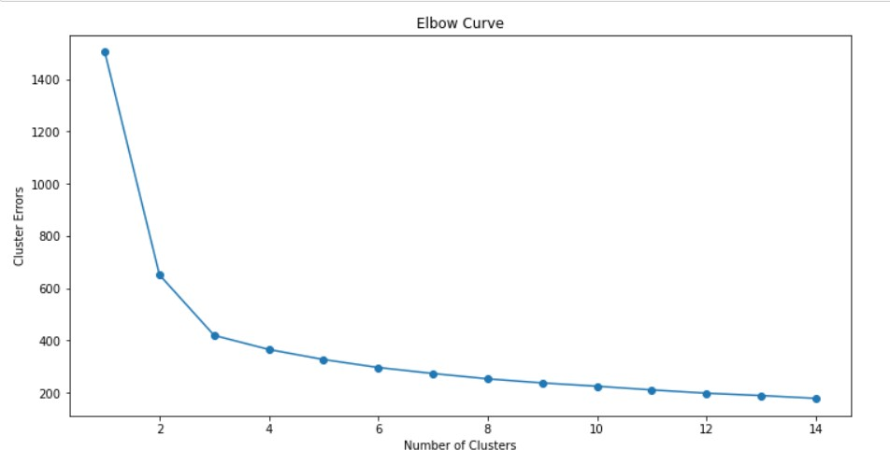
Finding Optimal number of Clusters
To find the Optimal number of Clusters, we used Elbow Curve method
From the curve, we could see the elbow at number of clusters
= 3
So, we decided to take Optimal Number of clusters for modelling as 3

Slide 7
Modelling - KMeans
Using Number of clusters as 3, and init method as “K-means ++” , we build the model using fit
method
Predicted the clusters using Predict method of Kmeans

Slide 8
Modelling – Hierarchical
Built the model using “Euclidean distance” as metric and linkage type as “Single”
Plotted the Dendrogram for single linkage, we won’t be able to observe good clusters in single
linkage
Built the model using Complete Linkage, we could clearly observe 3 clusters formed.
Used Cut_tree with n_clusters = 3 to get the labels of the clusters formed

Slide 9
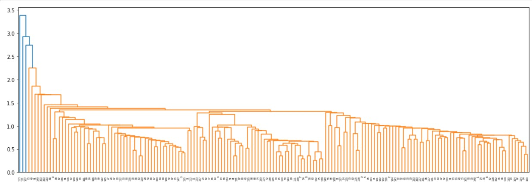
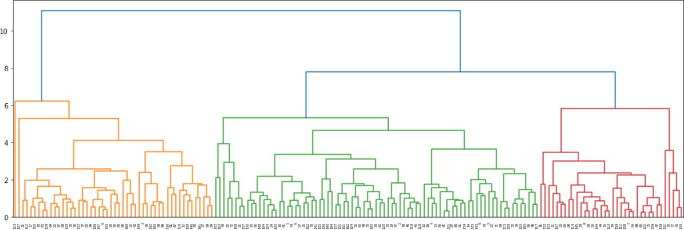
Modelling - Hierarchical
SINGLE LINKAGE
COMPLETE LINKAGE

Slide 10
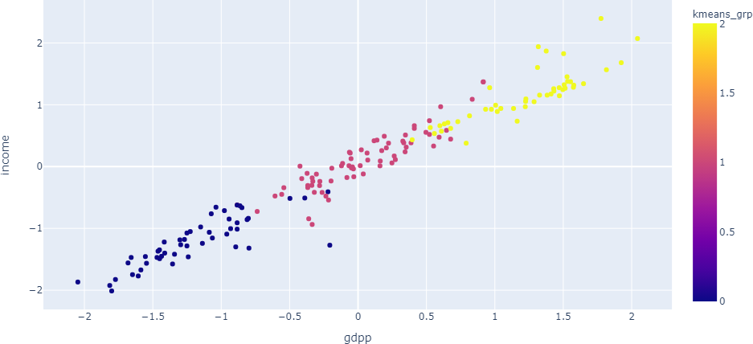
Visualisations – gdpp vs income

Slide 11
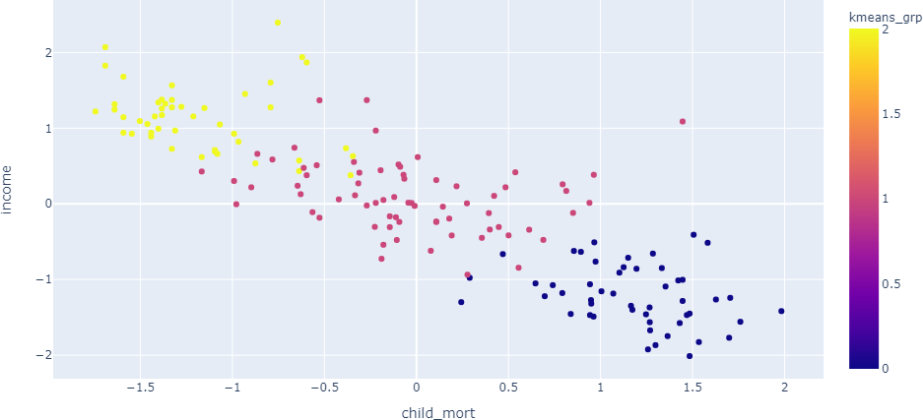
Visualisations – child_mort vs income

Slide 12
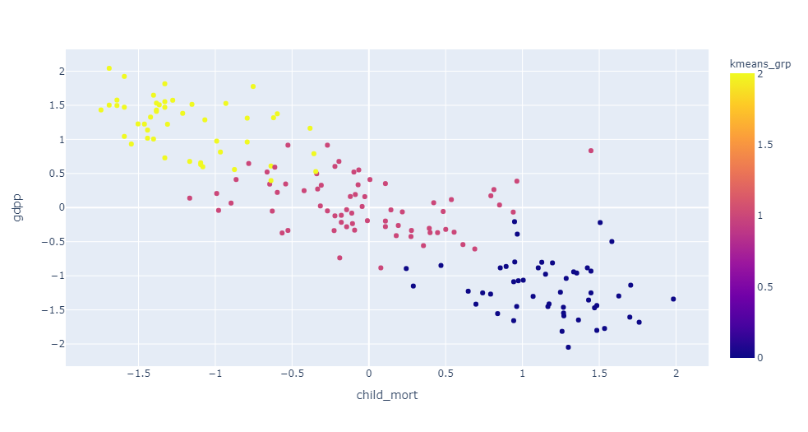
Visualisations – child_mort vs gdpp

Slide 13
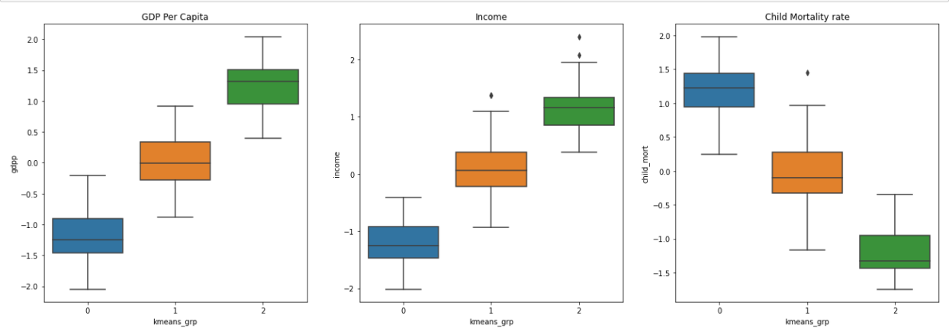
Boxplots of Clusters formed

Slide 14
Interpretation
From the box plots and scatter plots, we could see the cluster formations clearly
From these we label the clusters formed as :
Cluster - 0 : High Child Mortality, Low Income and Low GDP
Cluster - 1 : Average Child Mortality, Average Income and Average GDP
Cluster - 2 : Low Child Mortality, High Income and High GDP
So, we can conclude that Cluster 0 has High Child mortality rate, low income and low GDP, which is contains the poor countries.
We have a total of 50 poor countries

Slide 15
Result
From the list of poor countries we obtained, sorted the list on income, gdpp, child_mortality rate.
Top 5 countries which are in direst need :
Congo, Dem Rep
Liberia
Burundi
Niger
Central African Republic
Based on Business needs, we can change the sort order to get different list

